Slide 1
Title: Sales Project On Superstore Subtitle: Data-Driven Insights from Sales Dataset Your Name: Gollapalli Ganesh Data Science/Data Analytics Submitted To: Kavi Bharathi
SQL PROJECT

Slide 2
INTRODUCTION
Objective :-
Demonstrate proficiency in SQL by performing comprehensive analysis on a sales dataset to extract actionable insights.
Dataset Details:
Over 9500 rows.
Includes sales, profits , Discounts, customer segments, Shipping mode ,Country , City , State , Postal Code , Category , Sub-Category and regions.
Goal: Demonstrate proficiency in SQL for data analysis.

Slide 3
Tools and Technologies
Database: MySQL Workbench
Language: SQL
Skills Demonstrated:
Data filtering, grouping, joining tables.
Advanced query techniques (CTEs, subqueries).
Pivot Table
Aggregation
Operators
Nested queries
Windows Functions

Slide 4
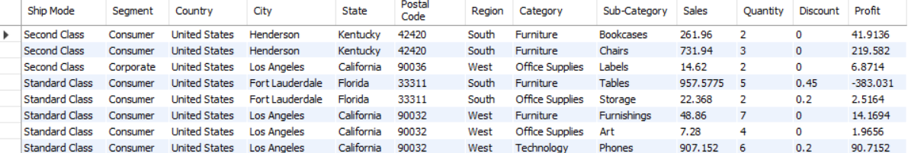
Dataset Overview
Attributes:
Ship Mode, Segment, Country, City, State
Region, Category, Sales, Quantity, Discount, Profit
Sample Records:

Slide 5
Dataset Challenges
Handling Limitations:
MySQL lacks EXCEPT and INTERSECT operators.
Workarounds: Using NOT IN and JOIN clauses.
Data Volume:
Efficient filtering and grouping for performance.
Insights Extraction:
Balancing granular and high-level insights.

Slide 6
Query Categories
Data Filtering: WHERE clause.
Aggregation: COUNT, SUM, AVG.
Joins: Inner, Outer, Left, Right.
Subqueries: Single-row, Multi-row, Nested.
Set Operations: Alternatives for MySQL.

Slide 7
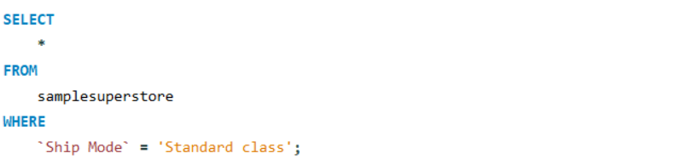
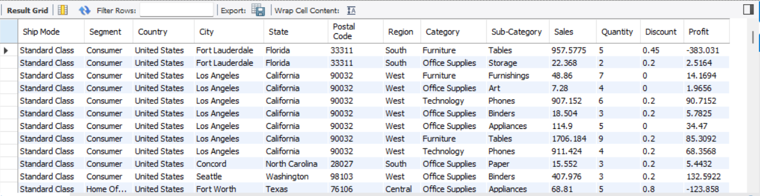
Selection Statement
Retrieving all columns for records where the ship mode is "Standard Class

Slide 8
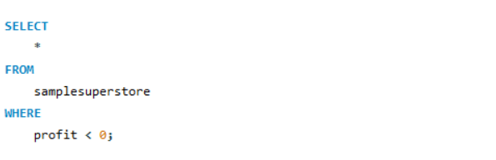
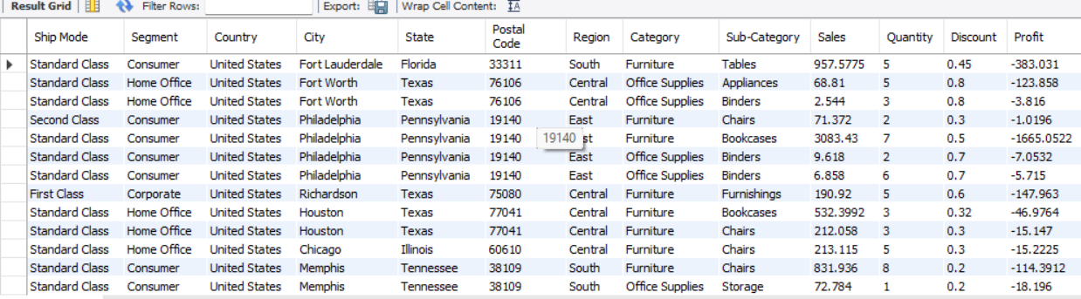
Filtering With Where clause
Loss Making Transaction

Slide 9
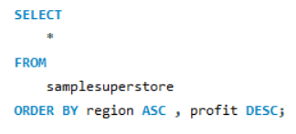
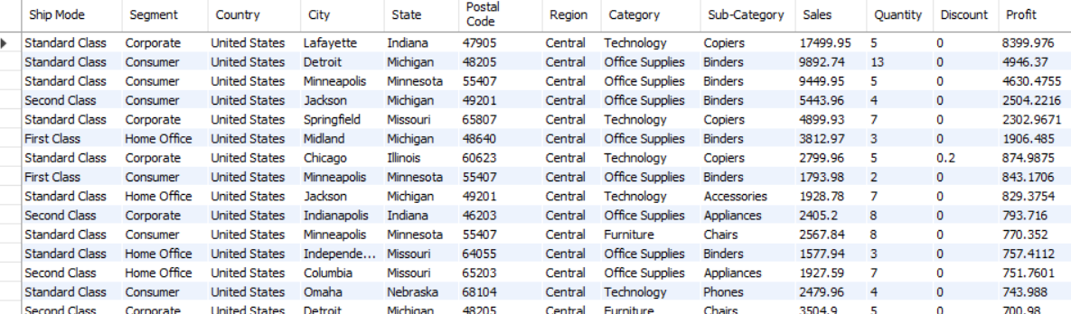
Order by Clause
Sorted first by region in ascending order and then by profit in descending order.

Slide 10
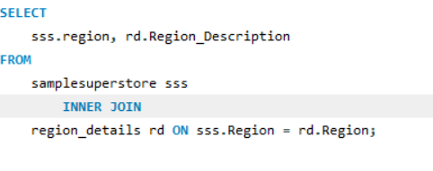
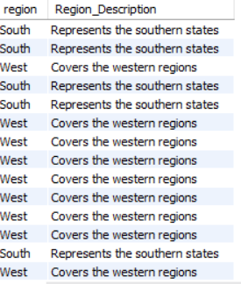
Joins
Inner join between sales _ data and a hypothetical region _ details table to get region descriptions.

Slide 11
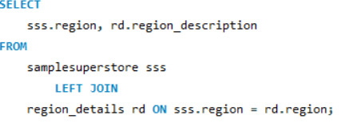
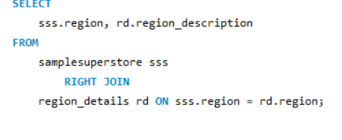
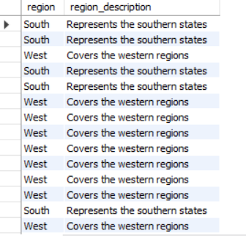
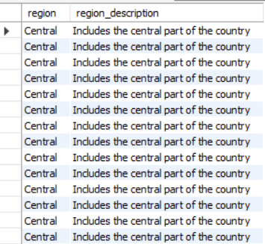
Joins
Left outer join and Right outer join to display region along with matching region descriptions.

Slide 12
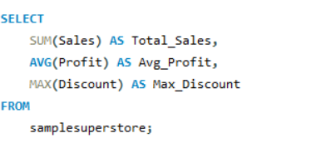

Aggregation
Calculating the total sales, average profit, and maximum discount for all transactions..

Slide 13
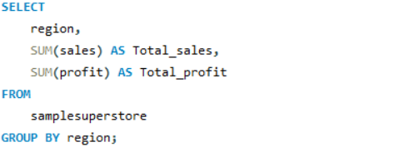
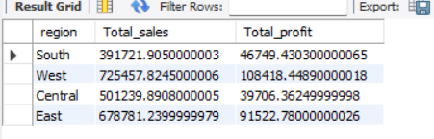
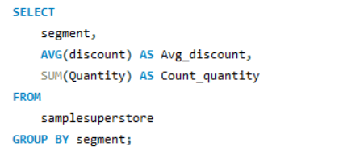
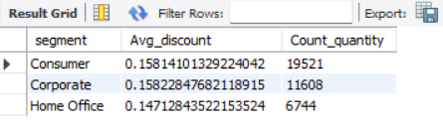
Grouping and Aggregation
Group data by region and find the total sales and profit for each region.
For each segment, calculate the average discount and total quantity sold.

Slide 14
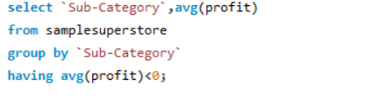
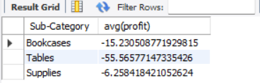
HAVING Clause
Sub-categories where the average profit is less than 0.

Slide 15
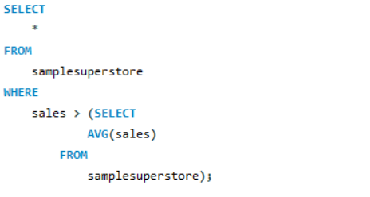
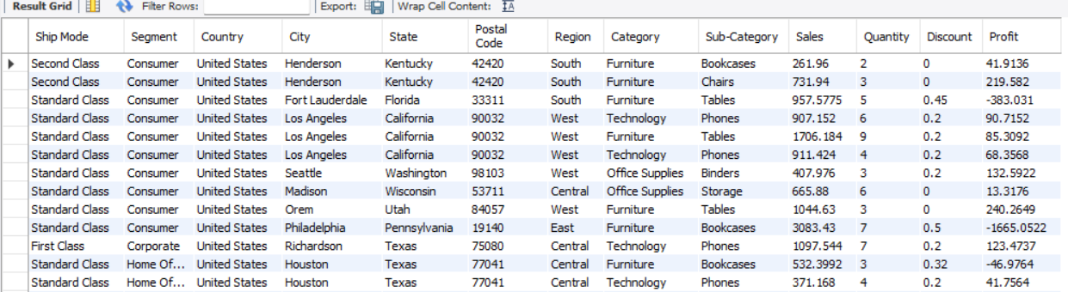
Subqueries
Transactions with sales greater than the average sales.

Slide 16
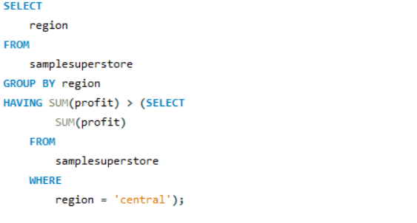
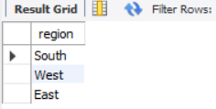
Subqueries
Regions where the total profit exceeds the total profit in the "Central" region.

Slide 17
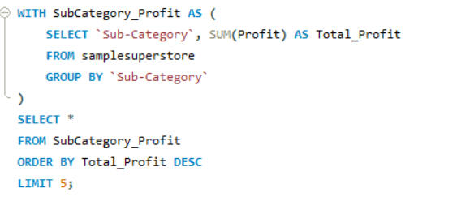
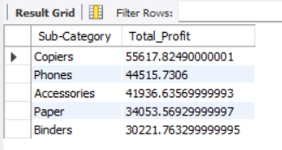
CTE’s
CTE to find the top 5 profitable sub-categories

Slide 18
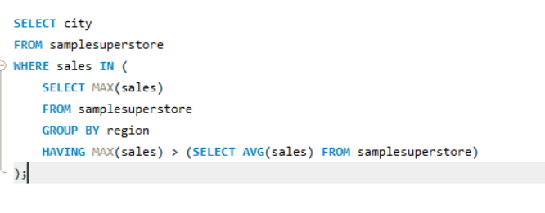
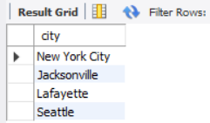
Nested Queries
Cities where the highest sales are greater than the average sales across all regions

Slide 19
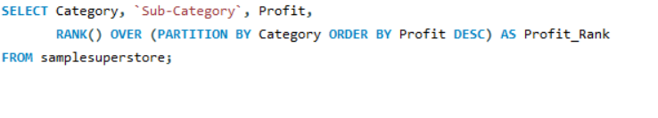
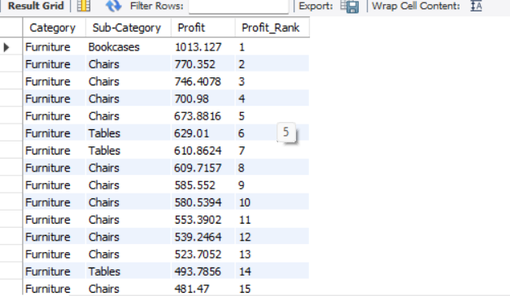
Windows Function
Rank products by their profit within each category.

Slide 20
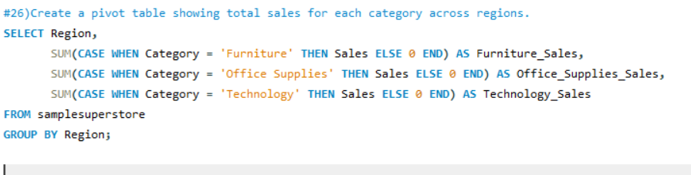
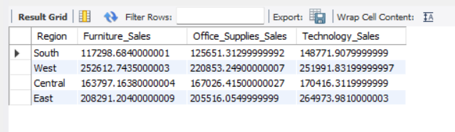
Pivot Table
Pivot table showing total sales for each category across regions.

